Slide 1
Predicting the Risk Factor of Car

Slide 2
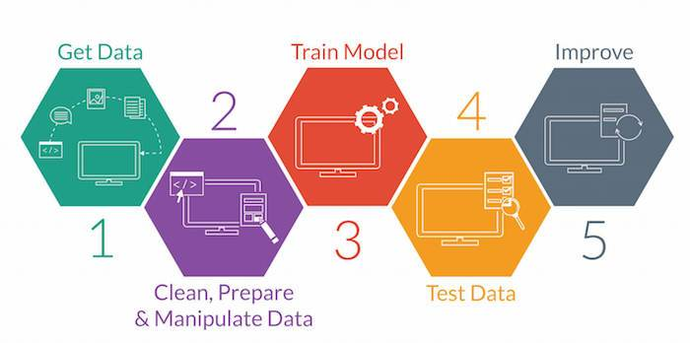
Machine Learning Modelling Steps

Slide 3
Variable Identification
As per the given dataset, we can say that
Dependent Variable : RiskFactor (Factors)
Independent Variable: Other Variables (Continuous and categorical)
We need to predict the RiskFactor of a car for a insurance company. Company categories risk with 6 factors
Factors : -2, -1, 0, 1, 2, 3

Slide 4
Exploratory Data Analysis
Data Pre-processing is one the important aspect where you can improvise the dataset. Pre-Processing steps involve
1. Uni-Variant Analysis
2. Bi-Variant Analysis
3. Missing Values treatment
4. Outlier Detection and treatment
5. Feature Engineering

Slide 5
Multi Collinearity
To improve accuracy the dataset need to be free from multi collinearity. It means, there should not be any dependencies amoung the independent variable.
If Exist, we should remove them, there are many way to treat multi collinearity, As this dataset consist of categorical and continuous variable, here VIF method is used.
VIF Method, helps us to identify which variables has more collinearity which enables us to show the variable name and we can remove the variable from dataset.

Slide 6
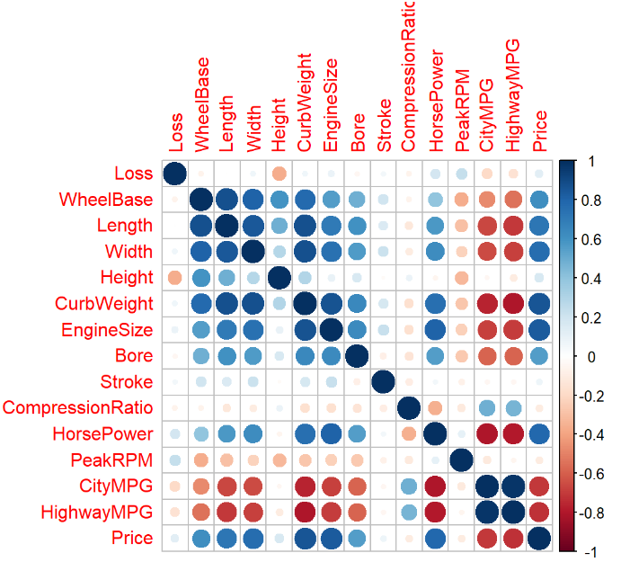
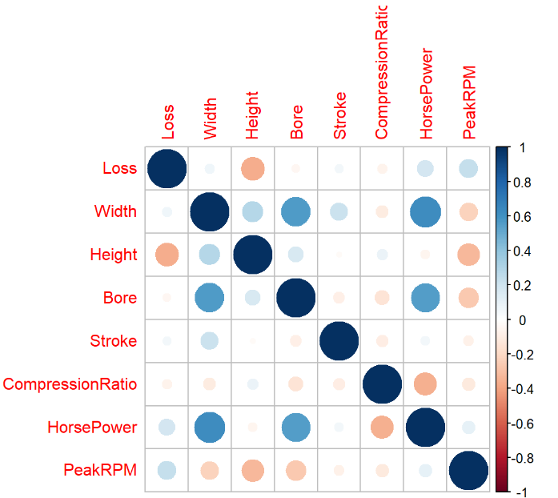
Solving Multicollinearity using VIF
After VIF

Slide 7
Cross Validation and Boruta Algorithm
Cross Validation:
To get the best train and test data set, Cross Validation is used and modelled the algorithm with the best set of data.
By using it, we can predict data with most accuracy and improve the models performance as well.
Boruta Algorithm:
It helps us to filter out the unimportant variable present in the dataset which helps us to reduce the complexity of the modelling.

Slide 8
Modelling
Dependent variable is categorical variable as -2, -1, 0, 1, 2, 3
It comes under classification problems. So the given dataset is modelled in various classification algorithm.
Various Algorithm Used like:
Support Vector Machine
Random Forest Classification
Decision Tree Algorithm
Logistic Regression

Slide 9
Performance Tuning
SVM Modelling has tuning parameter has kernel, Cost and Gamma Function which has been adjusted to improve the accuracy
Random Forest algorithm has tuning function as number of tree used and number of columns used for building a tree, Those tuning parameter are altered to improve the performance of the algorithm
Decision tree has to main types of algorithm like c5.0 and rpart most advantage of these algorithm is deals with variable selection by themselves which improvise the accuracy of the model
Have applied Multinom function for Logistics regression for modelling the variable since it has more than 2 factors

Slide 10
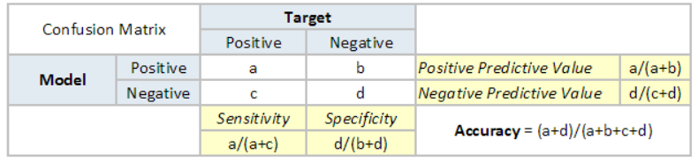
Model Evaluation Metrics
Have used confusion matrix as evaluation metrics to calculate the model accuracy
Confusion matrix, Enables us to calculate the accuracy, sensitivity and specificity.

Slide 11
Conclusion
By modelling five different models, It concludes that Decision Tree c5.0 gives more accuracy in Test data which is segregated by cross validation but overall accuracy of c5.0 model is very less. So, if we test the same models with new data, there is a chance for inaccuracy.
But, When it comes to random forest, It tops overall accuracy with 0.87, which shows that models can perform very well with new data as well as exist data.
It has very good overall accuracy, where the overfitting problem wont exist in this case.
So, For the mentioned dataset, Random Forest modelling works well than any other modelling for predicting new test data

Slide 12
References
EDA Analysis – Analytics Vidhya https://www.analyticsvidhya.com/blog/2016/01/guide-data-exploration/
Modelling -Analytics Vidhya https://www.analyticsvidhya.com/blog/2016/02/complete-tutorial-learn-data-science-scratch/
Youtube
Kaggle
Udemy

